Slide 1
DSPS : NavBot

Slide 2
What is NavBot
___________________________________________________________________________________________________
It is a prototype of DSPS which navigates in deep space with the knowledge and algorithms of mathematics (trigonometry), physics (angular velocity), triangulation.
The following questions will be answered in the following slide:
Q1. What are its features ?
Q2. In which programming languages is it programmed ?
Q3. Is it compatible on any surface ?
Q4. What are the input methods for this robot ?
Q5. Is it able to move a large distance without any problems ?
Q6. Problems encountered when building it ?
Q7. By which microcontroller is it powered ?

Slide 3
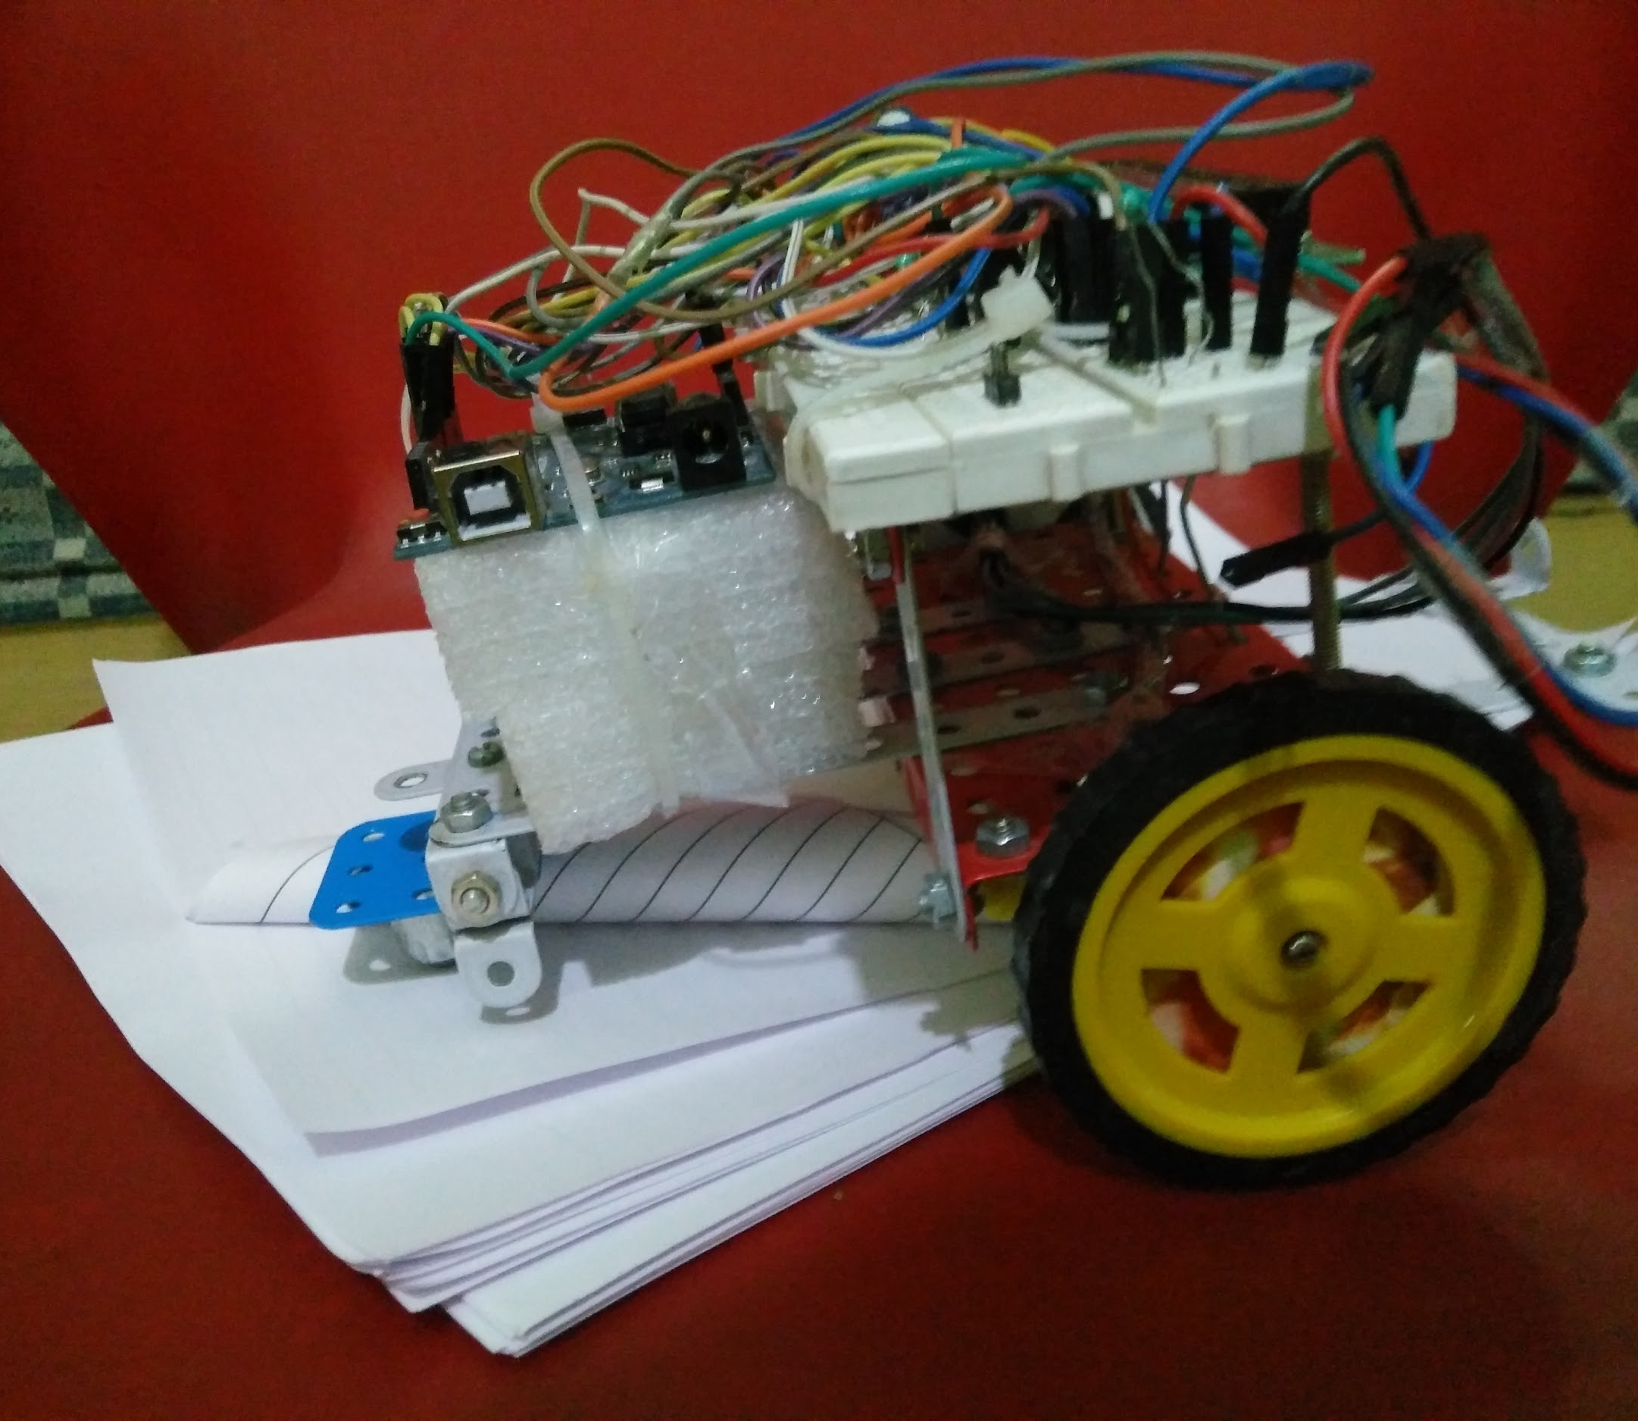
Design
1
The following slides explain the design of my NavBot.

Slide 4
Parts Used
Arduino Uno R3
DC motor (100 rpm)
LCD display (16, 2)
Wheels
IR Photodiodes and IR LED
Styrofoam
Power Bank (4000 mAh)
Let’s get started with their usage in my NavBot.

Slide 5
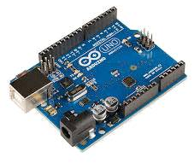
Arduino UNO R3
The Arduino Uno is a microcontroller board based on the ATmega328P. It has 14 digital input/output pins (of which 6 can be used as PWM outputs), 6 analog inputs, a 16MHz quartz crystal, a USB connection, a power jack, an ICSP header and a reset button. It contains everything needed to support the microcontroller; simply connect it to a computer with a USB cable or power it with a AC-to-DC adapter or battery to get started.
It is the heart of my NavBot as it does various tasks in one go like comparing variables, running motors, getting values from sensors etc.

Slide 6
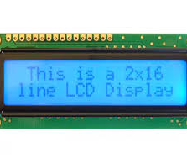
LCD (16 X 2)
LCD (Liquid Crystal Display) screen is an electronic display module and find a wide range of applications. A 16x2 LCD display is very basic module and is very commonly used in various devices and circuits. These modules are preferred over seven segments and other multi segment LEDs. The reasons being: LCDs are economical; easily programmable; have no limitation of displaying special & even custom characters (unlike in seven segments), animations and so on.
A 16x2 LCD means it can display 16 characters per line and there are 2 such lines. In this LCD each character is displayed in 5x7 pixel matrix.

Slide 7
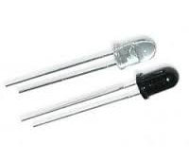
IR LED and IR Photodiode
Infrared rays are those rays which are invisible to us as they are too small to be seen by us (940 nm). IR LED is a LED which gives IR rays as it produces mechanical oscillation of 680 - 690 mHz. IR rays are reflected by shiny and light surfaces but are absorbed by dull and dark surfaces.
This property is used in various application in robotics like
Optical Encoders
Line following robot
And much more.
IR photodiode is a Reverse Bias LED which means it collects light. It is usually covered with black plastic to avoid rays other that Infrared to pass through.

Slide 8
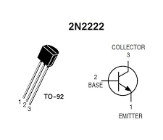
2N2222 Transistor
As we all know that Arduino can only supply power upto 40a which is far more less than what a DC motor requires. So we need to amplify the power to control DC motors. One such way is using transistors. Connecting B of transistor to the Arduino Digital Pin and C to negative rail of breadboard and then E to the motor’s pin will allow us to control the Dc motor’s input power. I used 2N222 transistor for the purpose.
Transistors have 3 pins
Collector/Source/C
Base/Power/B
Emitter/Drain/E
These all pins work in a series to control the DC motor with Arduino.

Slide 9
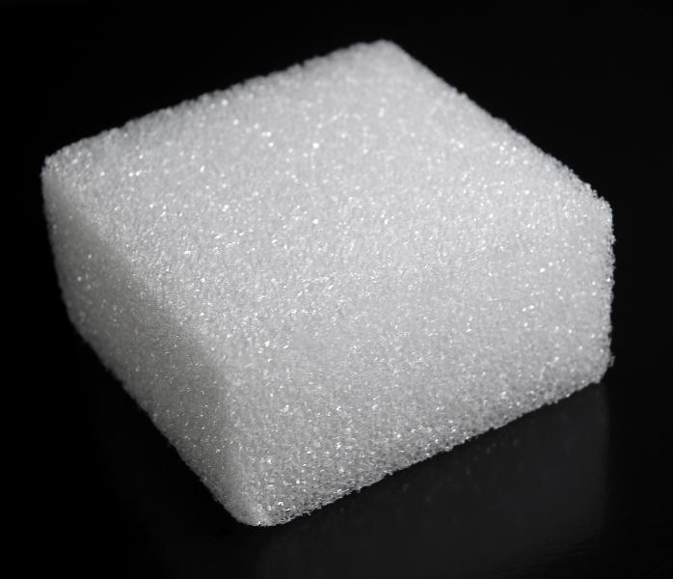
Styrofoam
Styrofoam is actually the trade name of a polystyrene, which is a petroleum-based plastic. Polystyrene is a lightweight material, about 95% air, with very good insulation properties and is used in all types of products.
As the pins of Arduino UNO board are exposed on the other side it creates a problem that I might short circuit when kept on a metal platform.
So I designed a styrofoam bed to insulate Arduino’s back and also decreases the chance of damage due to stones, digs etc.

Slide 10
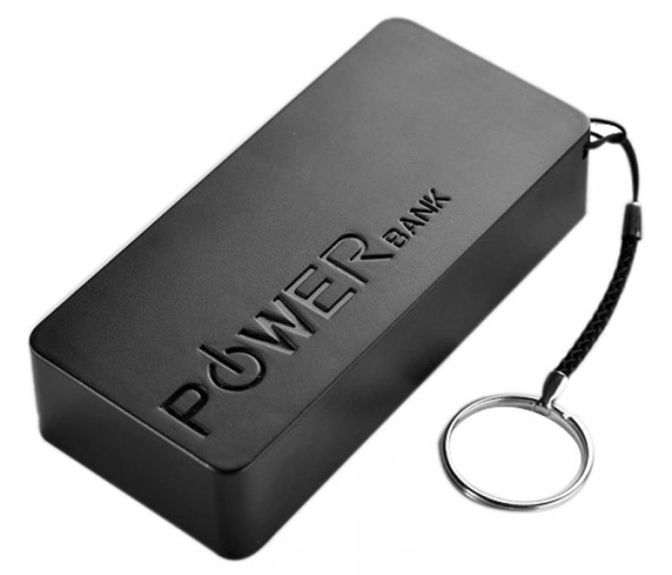
Power Bank
Portable Power Banks are comprised of a special battery in a special case with a special circuit to control power flow. They allow you to store electrical energy (deposit it in the bank) and then later use it to charge up a mobile device (withdraw it from the bank).
I used Bell Power Bank of 4000 mAh to power up my Arduino robot. I made a carriage for holding it in place at the back of the NavBot

Slide 11

Programming
Here comes the programming IDE and languages.

Slide 12
Arduino : IDE
Arduino has launched it’s own IDEs which uses various C functions for keywords. With my earlier of C language, I found it easier to program it. I also used RobotC for programming but got my head struck with the interface. I used 1.0.6 for programming.
But before that I learnt C and C++ to clear up my mis words and then I was able to program up the NavBot very smoothly.

Slide 13
Hardware & Software Issues
Going Straight:
As two motors are never same I had a hard time fixing this problem. I implemented various filters but was not impressed by anyone of it. Then finally I used MPU6050 Gyroscope and accelerometer to just measure the turned angle and the applying the power to the motors for straightening up.

Slide 14
2) Compactibility on any surface:
I have made the robot in such a way that it could navigate on any surface as no value is dependent on friction, weight and other variable properties. Since I have used MPU6050, I was able to get nice results.

Slide 15
Thanks!

